Slide 1
Exploring Daily Weather Patterns in State College, Pennsylvania
2026-04-27

Slide 2
01
Introductio

Slide 3
1 Introduction
Research Objective: This analysis aims to examine daily weather patterns at Pennsylvania State College.
Research Question: The primary focus is on the patterns of change in daily weather at State College over the past decade.
Data Source: The data comes from NOAA’s Global Historical Climate Network, specifically from the weather station in State College, PA, US, with station ID GHCND:USC00368449.
Variable Description: Key variables include daily maximum temperature, minimum temperature, precipitation, snowfall, and snow depth.

Slide 4
02
Exploratory Data Analysis

Slide 5
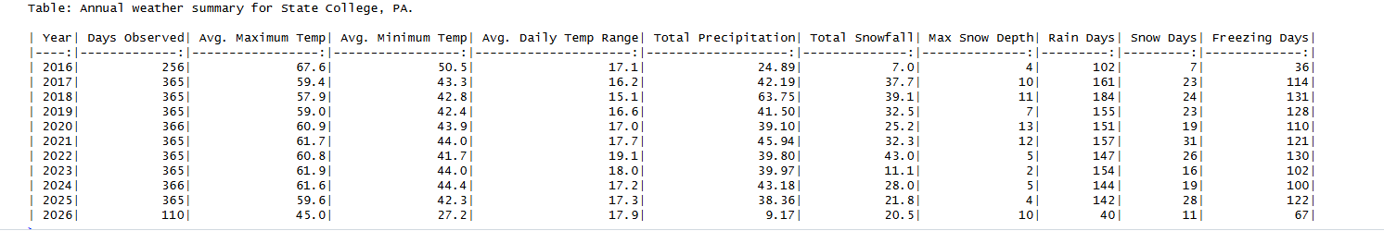
2.1 Annual Weather Summary
Annual Summary: : Table 1 provides a summary of annual weather records, with full years consisting of 365 or 366 days.
Precipitation: The highest total annual precipitation occurred in 2018, while the highest total snowfall occurred in 2022.
Temperature Overview: The annual average high temperature for a full year generally ranges from 50 to 60 degrees Fahrenheit.

Slide 6
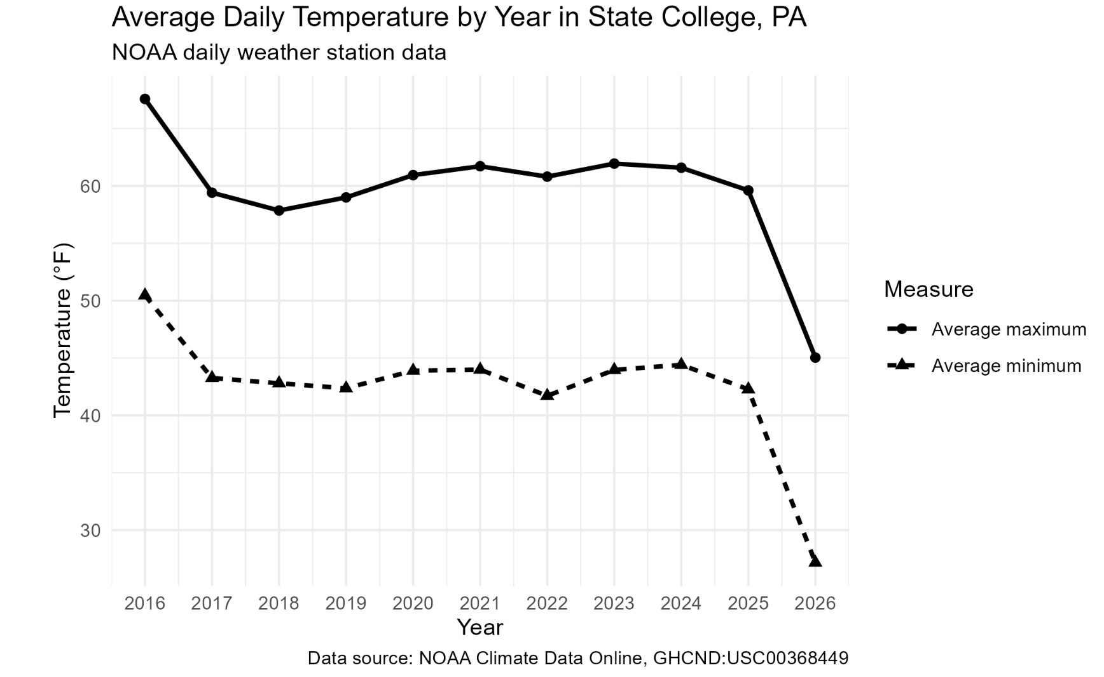
2.2 Annual Temperature Pattern
Temperature Patterns: Figure shows that the average annual maximum and minimum temperatures remain stable, hovering around 60°F.
Impact of Partial Data: The 2026 data appears unusually cold, but this is because it does not cover the entire year.
Long-Term Climate Trends: The cooling trend observed in 2026 should not be interpreted as a long-term pattern.

Slide 7
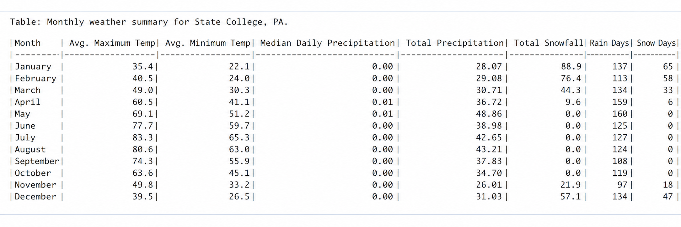
2.3 Monthly Weather Summary
Month-by-Month Comparison: Table 2 shows the monthly averages and totals, illustrating the seasonal climate pattern.
Temperature Cycle: The average high temperature is highest in July and lowest in January.
Snowfall Distribution: Snowfall is concentrated primarily in winter and early spring.

Slide 8
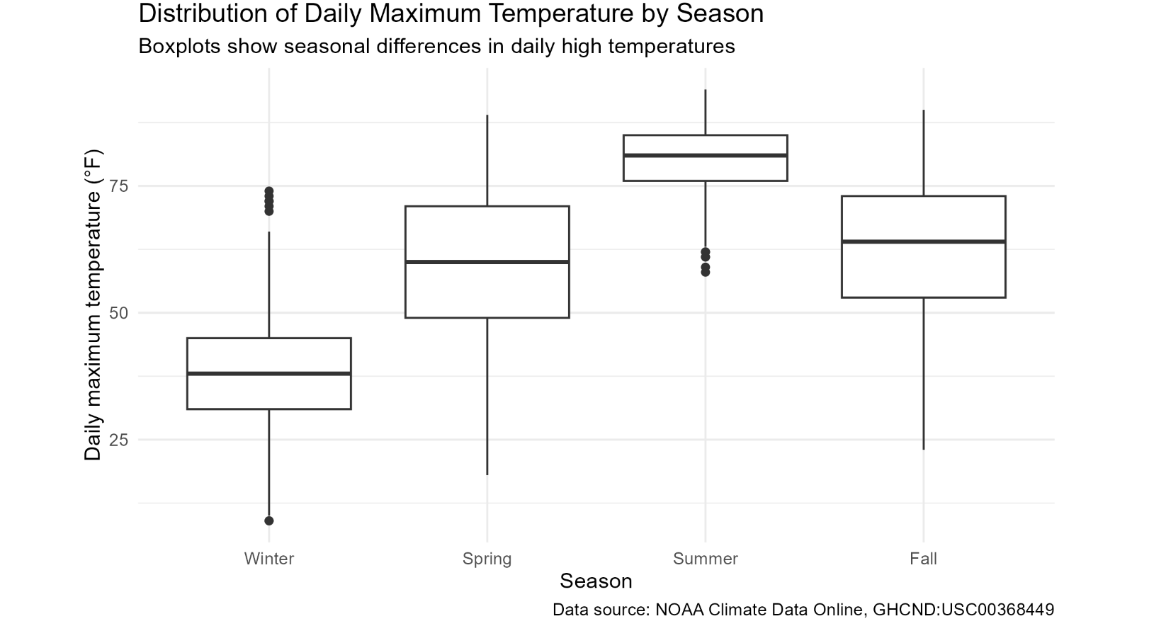
2.4 Seasonal Temperature Distribution
Seasonal Variations: Figure 4 shows the seasonal distribution of daily maximum temperatures, with the highest values occurring in summer and the lowest in winter.
Seasonal Variability: Spring and fall exhibit greater temperature fluctuations.
Summer vs. Winter: The median temperature is higher in summer, while winter features several warmer outliers.

Slide 9
03
Overall Data Story

Slide 10
Key Findings
Seasonal Patterns: The climate at the state college exhibits distinct seasonal variations.
Precipitation: Precipitation is heaviest during the spring and summer months, while snowfall is concentrated in the winter and early spring.
Understanding Data Distribution: It is important to distinguish between the characteristics of daily, monthly, and annual data.
Year-to-Year Comparisons and Considerations: The inclusion of data from certain years can influence comparative analyses.

Slide 11
04
Code Appendix

Slide 12
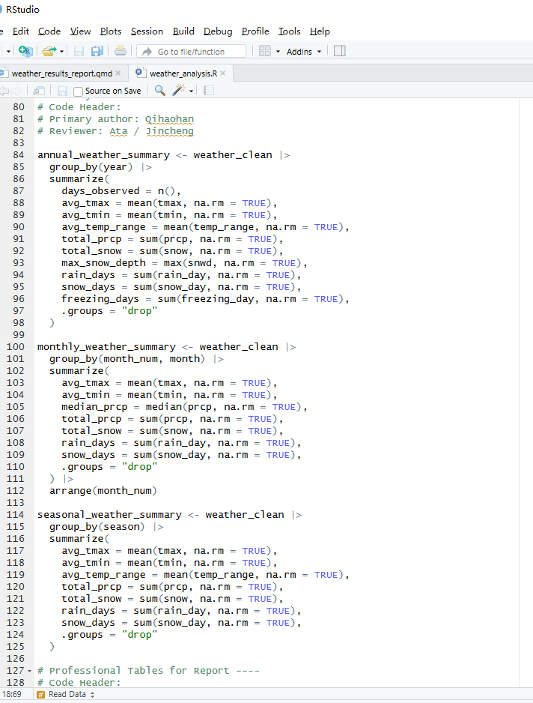
Code Appendix
R Code Overview: The code is used to read, clean, summarize, and visualize data so that the focus can be on interpreting the results.

Slide 13
THE END
THANKS

